Slide 1
Lab 2
Ying shen
Sse, tongji university
Nov. 2016

Slide 2
LIBSVM
LIBSVM -- A Library for Support Vector Machines
url: http://www.csie.ntu.edu.tw/~cjlin/libsvm/
User guide: http://101.96.10.63/www.csie.ntu.edu.tw/~cjlin/papers/guide/guide.pdf

Slide 3
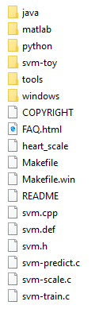
Experimental content
Try graphic Interface of libsvm
Download libsvm:
zip file: http://www.csie.ntu.edu.tw/~cjlin/cgi-bin/libsvm.cgi?+http://www.csie.ntu.edu.tw/~cjlin/libsvm+zip
tar.gz file: http://www.csie.ntu.edu.tw/~cjlin/cgi-bin/libsvm.cgi?+http://www.csie.ntu.edu.tw/~cjlin/libsvm+tar.gz
Unzip the target file

Slide 4
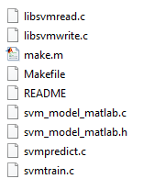

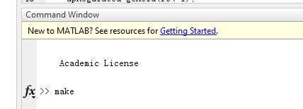
Experimental content
Go to /matlab directory
Open matlab and go to libsvm/matlab directory
Type make in the command window (make sure you have installed C++ compiler)

Slide 5

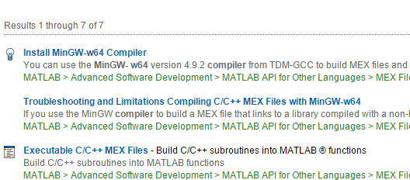
Install MinGW-w64 Compiler
If you have not installed C++ compiler, you can follow instructions in help document under Install “MinGW-w64 Compiler”

Slide 6
Options of libsvm
-s svm_type : set type of SVM (default 0)
0 -- C-SVC
1 -- nu-SVC
2 -- one-class SVM
3 -- epsilon-SVR
4 -- nu-SVR
-t kernel_type : set type of kernel function (default 2)
0 -- linear: u'*v
1 -- polynomial: (gamma*u'*v + coef0)^degree
2 -- radial basis function: exp(-gamma*|u-v|^2)
3 -- sigmoid: tanh(gamma*u'*v + coef0)

Slide 7
Options of libsvm
-d degree : set degree in kernel function (default 3)
-g gamma : set gamma in kernel function (default 1/num_features)
-r coef0 : set coef0 in kernel function (default 0)
-c cost : set the parameter C of C-SVC, epsilon-SVR, and nu-SVR (default 1)
-n nu : set the parameter nu of nu-SVC, one-class SVM, and nu-SVR (default 0.5)
-p epsilon : set the epsilon in loss function of epsilon-SVR (default 0.1)
-m cachesize : set cache memory size in MB (default 100)
-e epsilon : set tolerance of termination criterion (default 0.001)
-h shrinking: whether to use the shrinking heuristics, 0 or 1 (default 1)
-b probability_estimates: whether to train a SVC or SVR model for probability estimates, 0 or 1 (default 0)
-wi weight: set the parameter C of class i to weight*C, for C-SVC (default 1)

Slide 8
Experimental content
Download a dataset from https://www.csie.ntu.edu.tw/~cjlin/libsvmtools/datasets/
Train svm:
svmtrain
Test svm:
svmpredict
Try different parameters:
-t: 0 1 2 3
-g, -r, -d, -c

